Slide 1

More on Software Architecture
Dr. Mohamad Kassab

Slide 2
Why Things Go Wrong
Possible Failures:
Poor diagram semantics
Novel syntax
High creation effort
High comprehension effort
Communicate
System
Architecture
System
Architecture
Write
Architecture
Documentation
Read
You
Somebody
Else

Slide 3
Example
Controller Process (CP)
Propagation Loss Model (ModP)
Reverberation Model (ModR)
Noise Model (ModN)
Figure X: Overall Software System Structure

Slide 4
Example
Legend
Administrator Console
Façade Component
Web Component
LDAP Directory
Join Engine
Meta Viewer
RDBMS
Rule & Configuration DB
Integrated Data Rep
Direct Adapter
Indirect Adapter
Controller
Transaction Log
Viewer
Interface
SOAP Connector & roles
Direct Adapter1
Direct Adapter2
Indirect Aapter1
Indirect Aapter2
Adapter Manager
LDAP Connector & roles
Change Log
DB Connector & roles
RMI Connector & roles
Adapter Registry
Event Bus Connector & roles
System Boundary
External LDAP1
External LDAP2
External DB1
External DB2
Notes:
I put a big green box to clarify the system boundary again. Our skeleton for overall communication between component is based on the implicit invocation. The key point we have considered when we designed overall communication is the extensibility and modifiability. So we tried to make the components decoupled with each other by using publish and subscribe style.
There are 3 major components, Join engine that controls data flow and mapping based on the predefined rule sets, meta viewer that provides integrated data view to general user and administrators and lastly adapters that consists of direct and indirect ones.
The direct adapter is for LDAP directory based external repository and the indirect adapter is for RDBMS. Each adapter provides connections interfaces and some facilities for data exchanging
And there is two supplementary components to support this system. One is façade component that is for providing integrated interfaces of various component that allows an admin to access each component easily for controlling. And the other is adapter manager component that controls adapters connected to this system . It provides interface for removing or installing adapters in runtime. So through this component the admin controls adapters efficiently.

Slide 6
Example: Alternating Characters - Module View
Produce alternating case of characters in a stream
main
“sofTWareArchitecture” => “SoFtWaReArChItEcTuRe”
split
lower
upper
merge
Legend
config
input/output
Module
Definition/Use Modularization
Uses

Slide 7
Example continued: C&C View
lower
split
merge
upper
Legend
Filter
Components and Connectors
Pipe
Binding

Slide 8
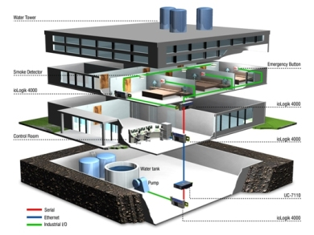
Building Automation System (BAS) – Case Study

Slide 9
Building Automation System
Consider a company that primarily sells hardware devices for building automation.
They have software applications that manage a network of these devices but this constitutes a loss leader, i.e. they lose money on the software but it helps the sale of the hardware devices.
The company realizes that the hardware is being commoditized and over time the profit margins on the sale of their hardware devices are going to shrink. In order to sustain their business long term, the company decides to create a new building automation system that will be profitable.

Slide 10
Building Automation System
They wish to accomplish this by doing two things
– reduce internal development costs and expand the market.
Internal development costs can be reduced by replacing several of the existing applications with a single building automation system.
Market expansion can be achieved by entering new and emerging geographic markets and opening new sales channel in the form of Value Added Resellers (VARs). VARs sell the new building automation system under their own brand to support building automation hardware devices of many different manufacturers.

Slide 11
Architectural Drivers
Architectural drivers are requirements that will shape the software architecture
Architectural drivers include:
Software
Architecture
Functional Requirements
Quality Attributes
Constraints

Slide 12
Architectural Drivers
Architectural Drivers for the Building Automation System
# | Architectural Driver | Priority
1 | Support for adding new field device | (H, H)
2 | International language support | (H, M)
3 | Non-standard unit support | (H, M)
4 | Latency of alarm propagation | (H, H)
5 | Load conditions | (H, H)

Slide 13
ADD Inputs and Outputs
Requirements
Functional
Quality
Constraints
ADD Process
Containers
Responsibilities
Interactions
Information flow

Slide 14
ADD Method
The Attribute-Driven Design (ADD) method (Bass et al., 2003), developed at the SEI, is one approach to defining software architectures by basing the design process on the quality attribute requirements.
In ADD, architectural design follows a recursive decomposition process where, at each stage in the decomposition, architectural patterns and tactics are chosen to satisfy a set of quality attribute scenarios .
The architecture designed represents the high-level design choices which are documented using multiple structures or views (we introduced these terms in an earlier lesson).
The nature of the project determines the views.

Slide 15
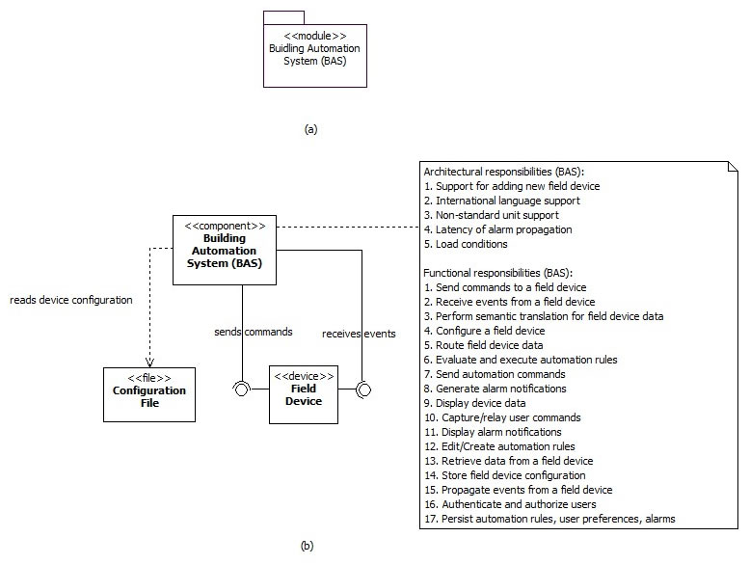
Building Automation System
We start with a monolithic system as shown in the next slide.

Slide 16
Building Automation System
Initially the monolith, being the only system component, is responsible for all functionality to be implemented along with satisfying all the architectural drivers.
Obviously, the monolithic structure can’t satisfy most of these architectural drivers and we use ADD to decompose it further until all of these drivers are satisfied.
We begin with one of our highest priority architectural driver 1 (support for adding new field device).

Slide 17
Architectural Driver 1
ADD applies the modifiability tactics to limit the impact of change and minimize the number of dependencies on the part of the system responsible for integrating new hardware devices.
There are three design concerns related with modifiability:
Localize changes: this relates to adding a new field device
Prevention of ripple effects: this relates to minimizing the number of modules affected as a result of adding a new field device
Defer binding time: this relates to the time when a new field device is deployed and the ability of non-programmers to manage such deployment

Slide 18
Architectural Driver 1
We address these concerns by creating adaptors for field devices, an anticipation of expected changes tactic.
We use two additional architectural tactics to minimize propagation of change.
First we specify a standard interface to be exposed by all adaptors (maintain existing interfaces).
Second, we use the adaptor as an intermediary responsible for semantic translation into a standard format, of all the data received from different field devices.
As a side effect, this also addresses architectural driver 3.

Slide 19
Architectural Driver 1
The adaptors are assigned the following responsibilities:
Send commands to the field device
Receive events from field device
Perform semantic translation for field device data

Slide 20
Architectural Drivers 1 & 3
Instantiating and allocating responsibilities to the adaptors leads to a realization that the building automation server is still sensitive to a change in the number of field devices it is connected to, and must include logic to route commands and data, to and from the correct adaptor.
To address this concern we use the hiding information tactic introducing an adaptor manager to hide information about the number and type of field devices actually connected.
The adaptor manager together with the adaptors creates a virtual device, that is, for all other components of the building automation system, there is practically one field device to interact with at all times.

Slide 21
Architectural Drivers 1 & 3
Additionally, the adaptor manager uses the following two architectural tactics to address the defer binding time design concern
Runtime registration: this will support plug-and-play operation allowing non-programmers to deploy new field systems.
Configuration files: this tactic enables setting of configuration parameters (such as initial property values) for the field systems at startup.

Slide 22
Architectural Drivers 1 & 3
The adaptor manager is assigned the following responsibilities:
(FR4) Route data to a field device

Slide 23
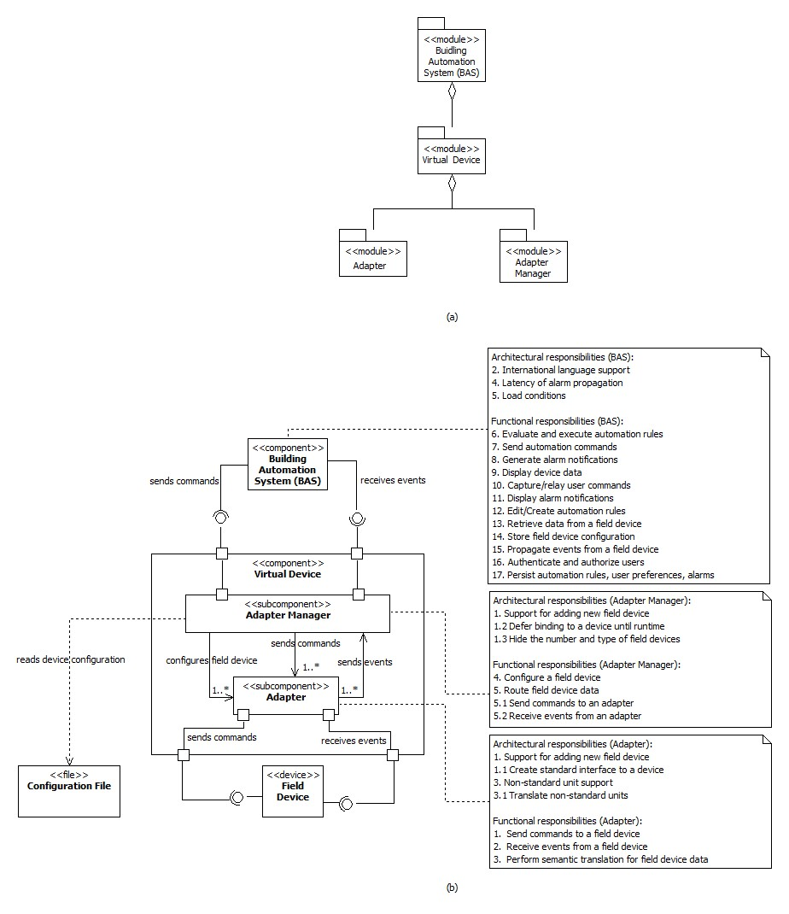

Slide 24
Architectural Driver 5
We next consider architectural drivers 5 related to the performance quality attribute of the Building Automation System and we also consider Constraint C2.

Slide 25
Architectural Driver 5
There are two design concerns related to these drivers:
Resource Demand: the arrival of change of property value events from the various field devices and the evaluation of automation rules in response to these events are source of resource demand
Resource Management: the demand on resources may have to managed in order to reduce the latency of event and alarm propagation

Slide 26
Architectural Driver 5
To address these concerns, we move the responsibility of rule evaluation and execution, and alarm generation, respectively to a separate Logic & Reaction (L&R) component and an Alarm component.
These components running outside the automation server can now be easily moved to dedicated execution nodes if necessary.
In doing so, we are making use of the increase available resources tactic to address the resource management concern and the reduce computational overhead tactic to address the resource demand concern.
We use an additional tactic to address the resource management concern. This tactic relies on introducing concurrency to reduce delays in processing time.
Concurrency is used inside the L&R and Alarm components to perform simultaneous rule evaluations.

Slide 27
Architectural Driver 5
We assign the following responsibilities to the L&R and Alarm components:
Evaluate and execute automation rules
Send automation commands
In addition, we assign the following responsibility to the Alarm component:
Generate alarm notifications

Slide 28
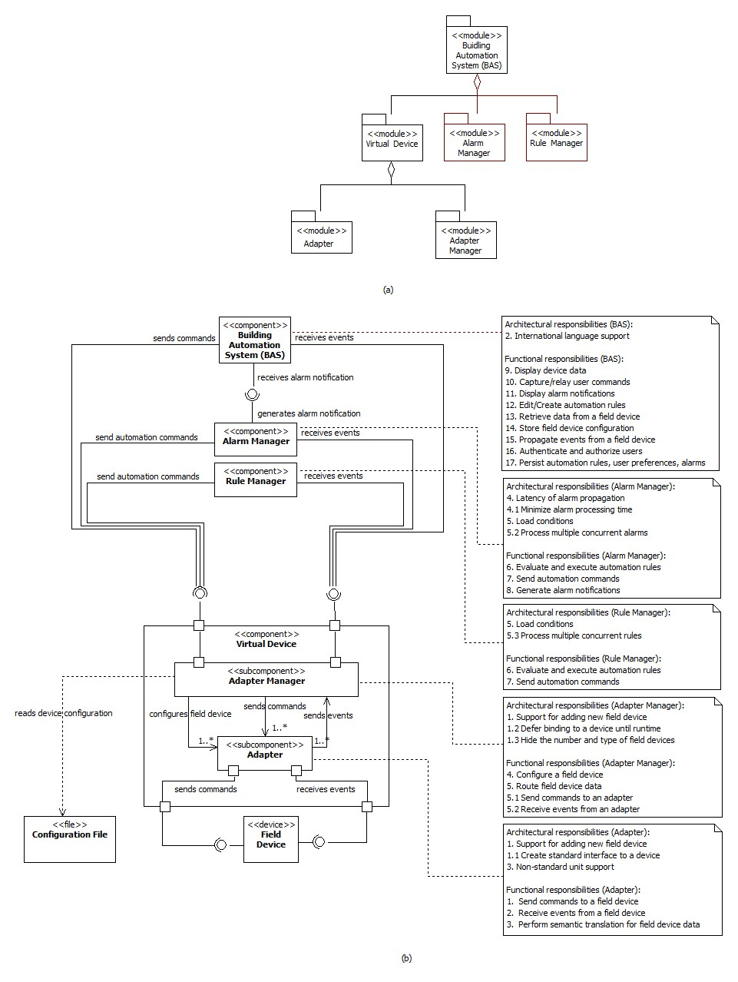

Slide 29

And the process goes on …

Slide 30


Readings , Assignments, Project Tasks
Read:
Chapter 10
Assignments & Project Tasks (Upcoming three items):
Your final presentations are already scheduled Tuesday (6/5), Thursday (8/5).
Project Deliverable 5 package is due on Friday (9/5)

